Slide 1

7TH AVENUE SEVOKE ROAD, SILIGURI BOUTIQUE RETAIL & OFFICE
CONSTRUCTION UPDATE 30.06.2025

Slide 2
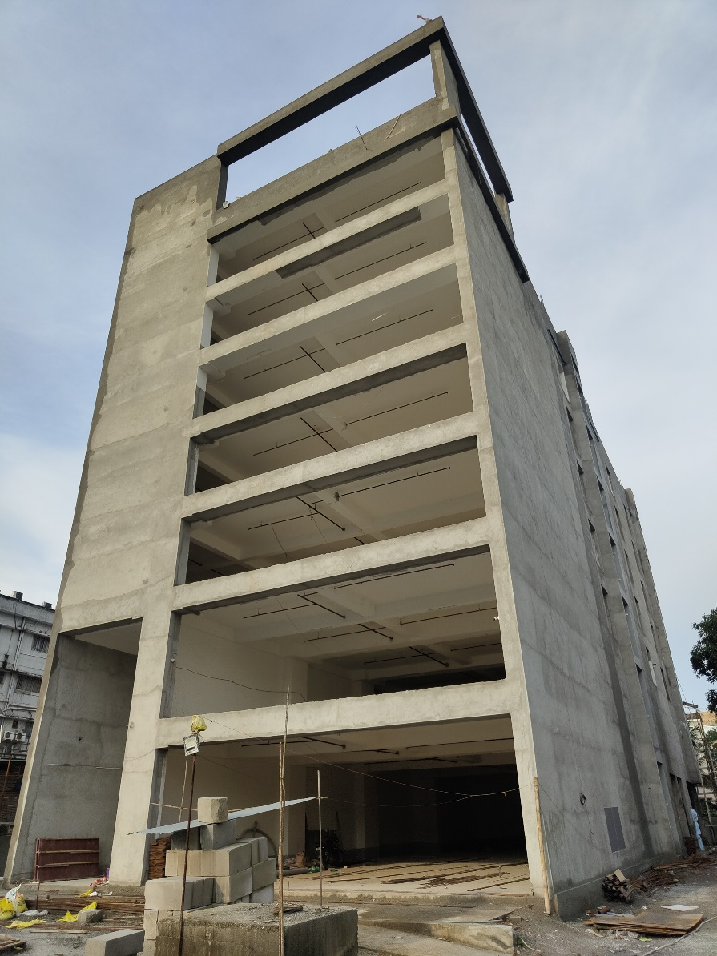
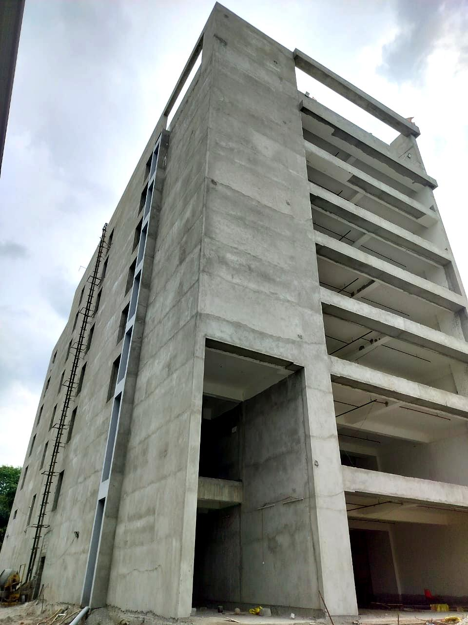
BUILDING EXTERIOR PLASTER COMPLETED

Slide 3
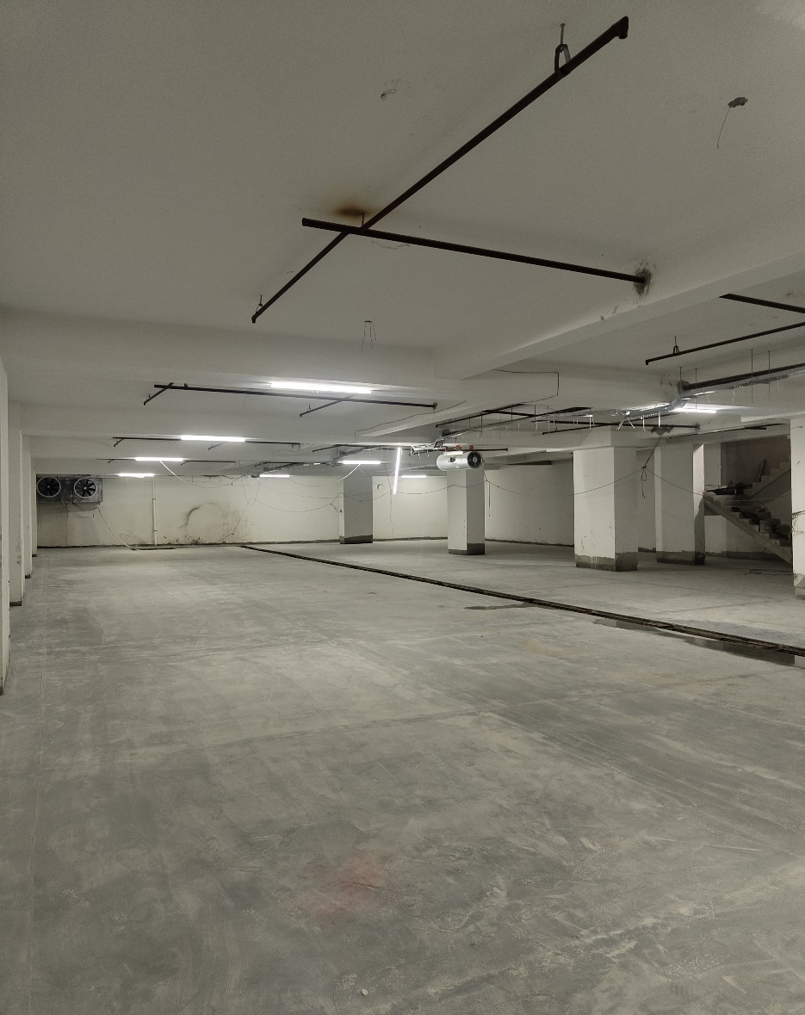
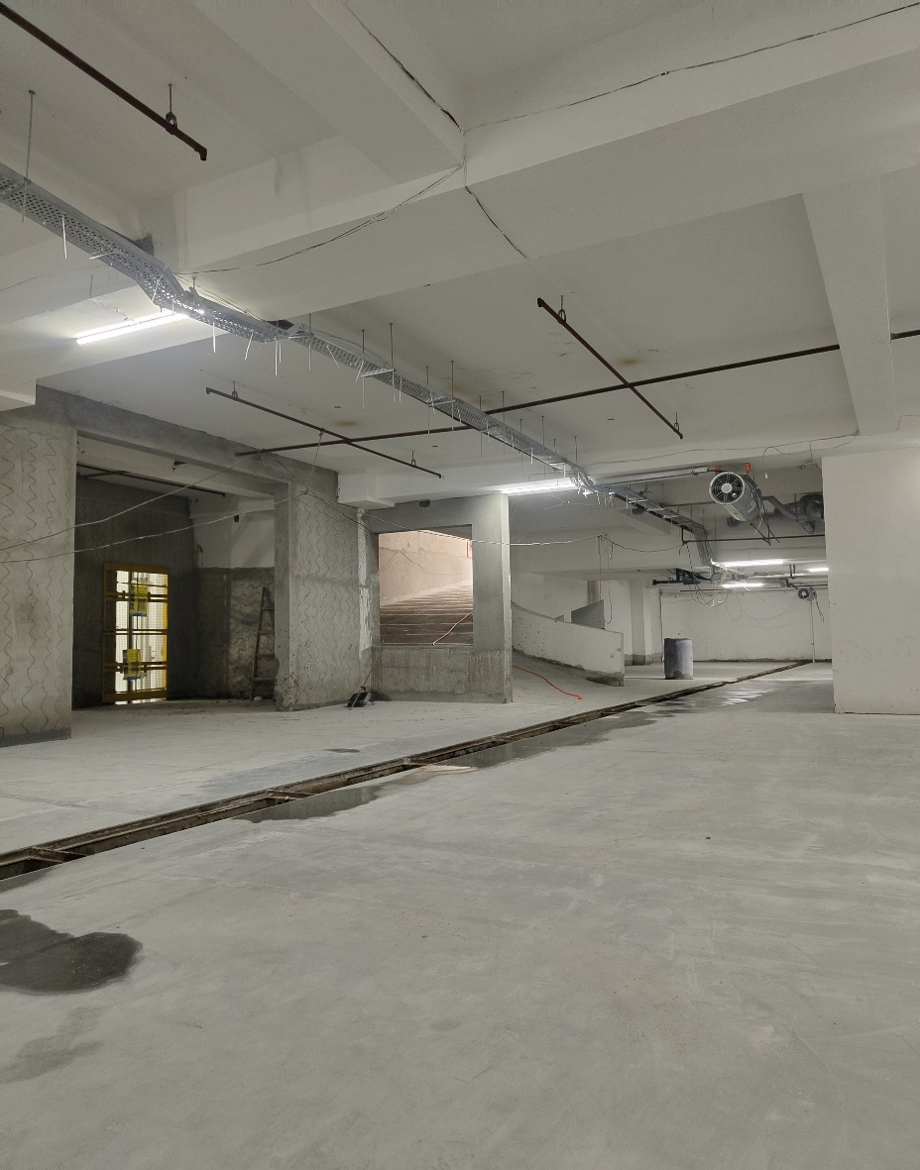
BASEMENT FLOOR , VENTILATION, DRAIN , PUTTY PRIMER COMPLETED

Slide 4
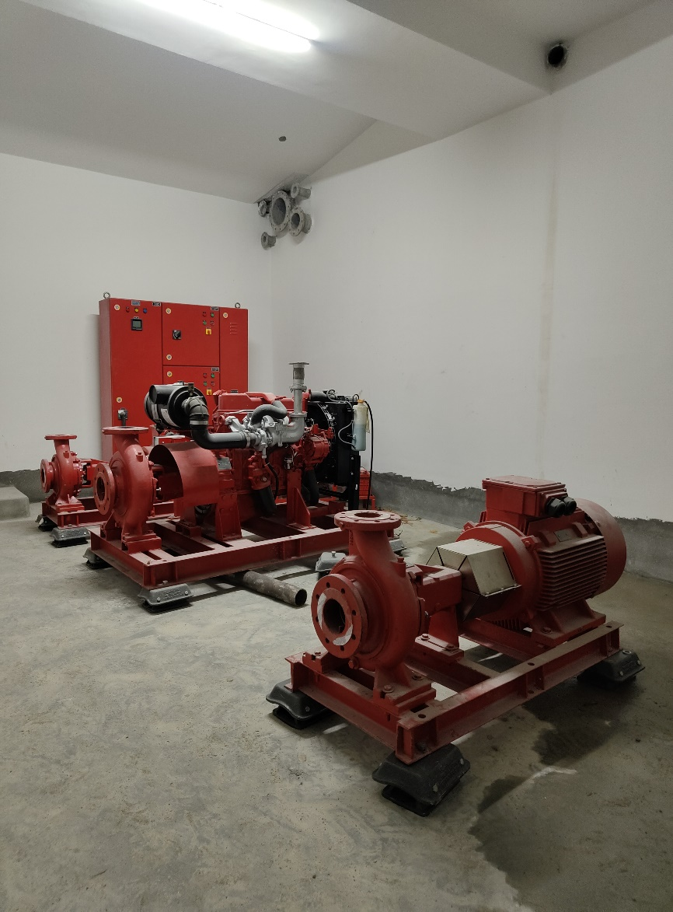
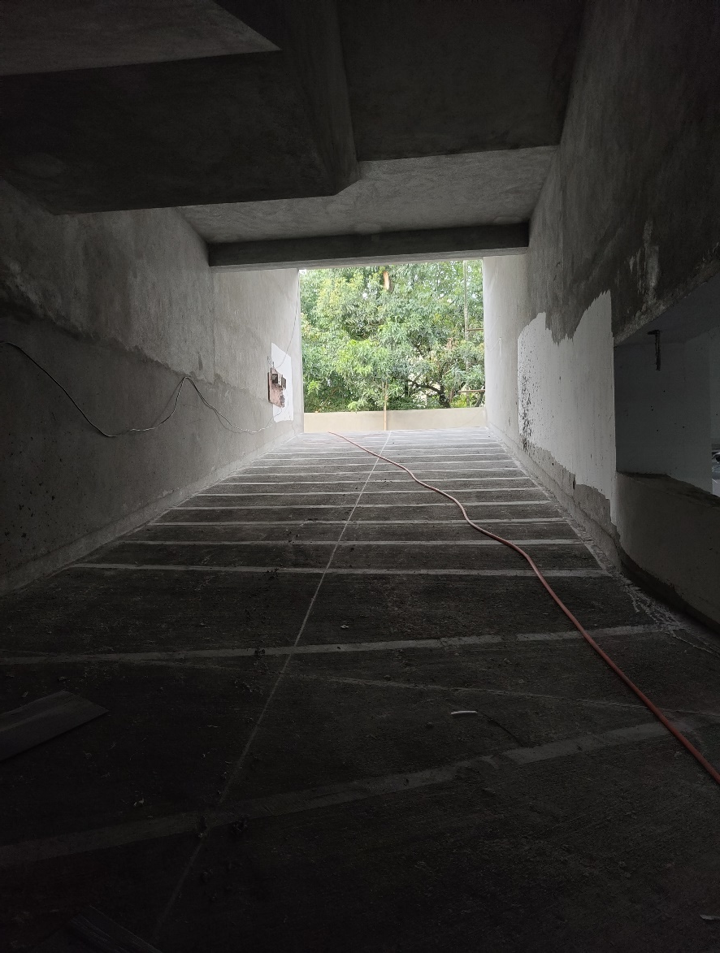
BASEMENT PUMP ROOM & RAMP

Slide 5
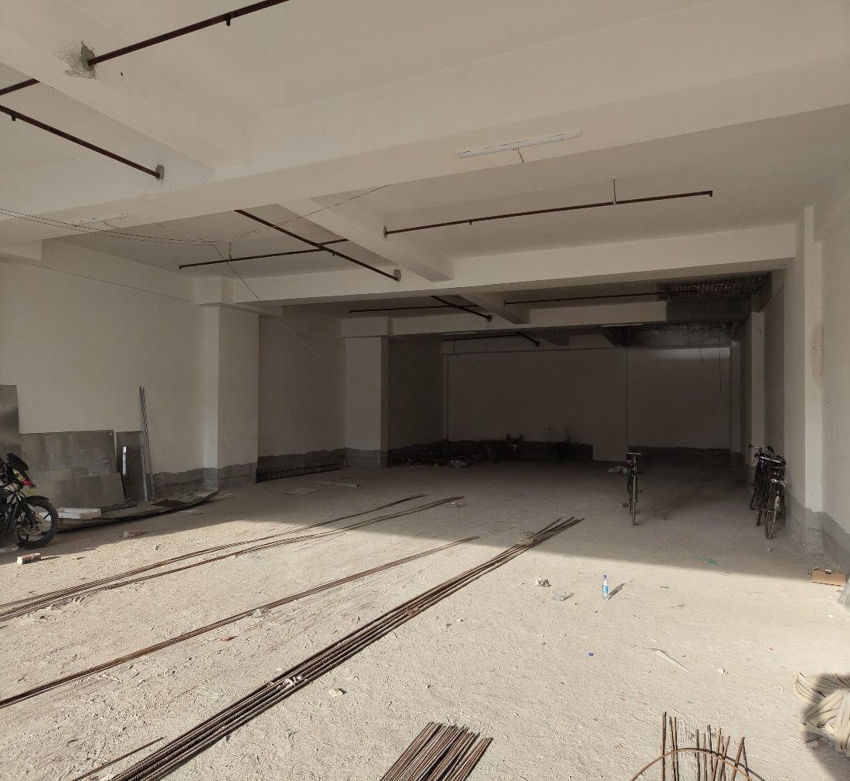
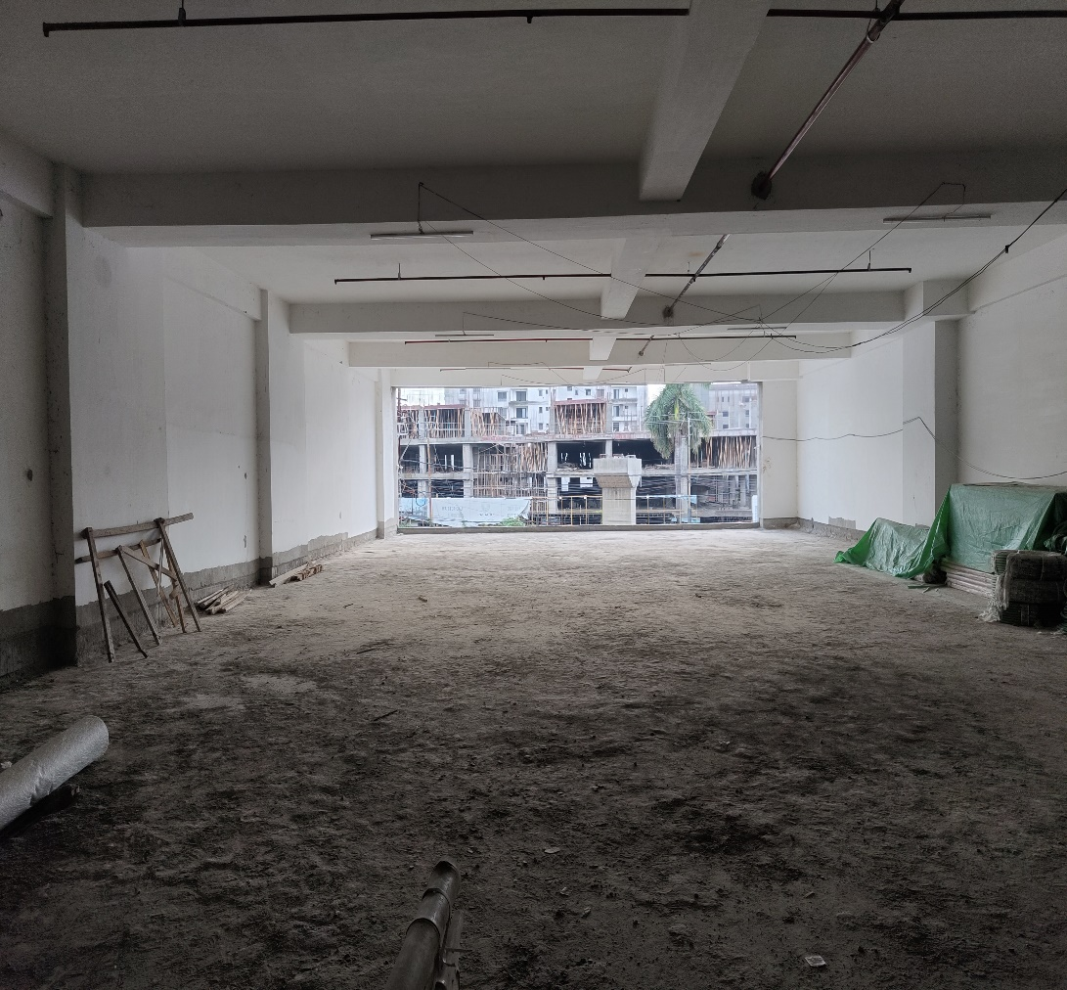
GR. & 1st FLOOR PUTTY PRIMER COMPLETED

Slide 6
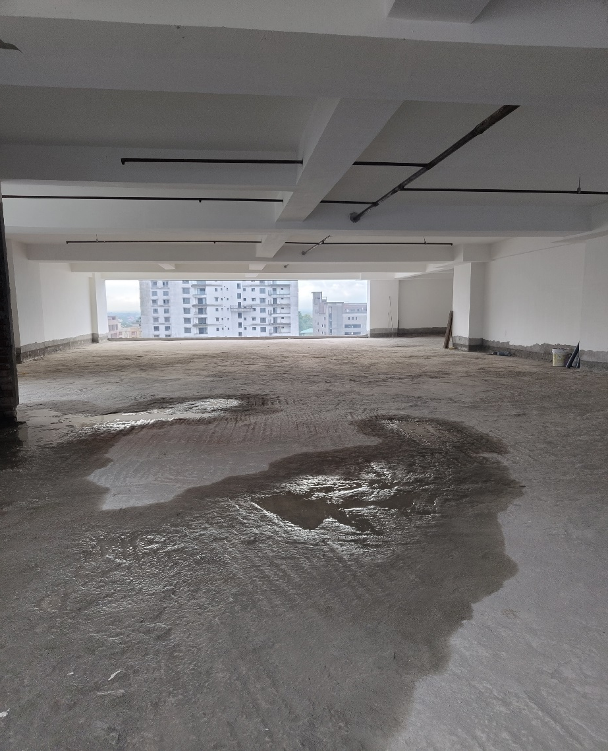
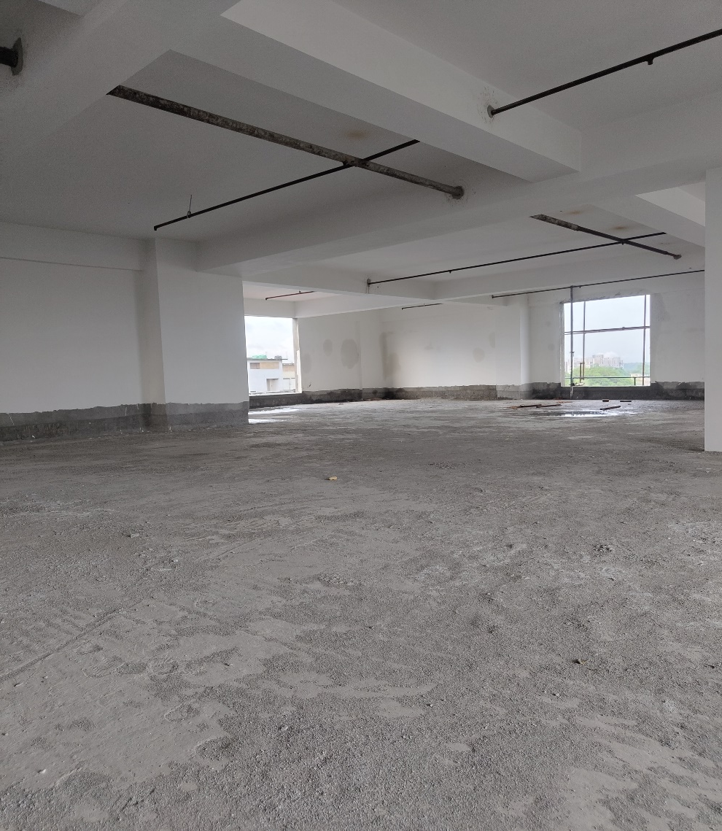
2nd & 3rd FLOOR PUTTY PRIMER COMPLETED

Slide 7
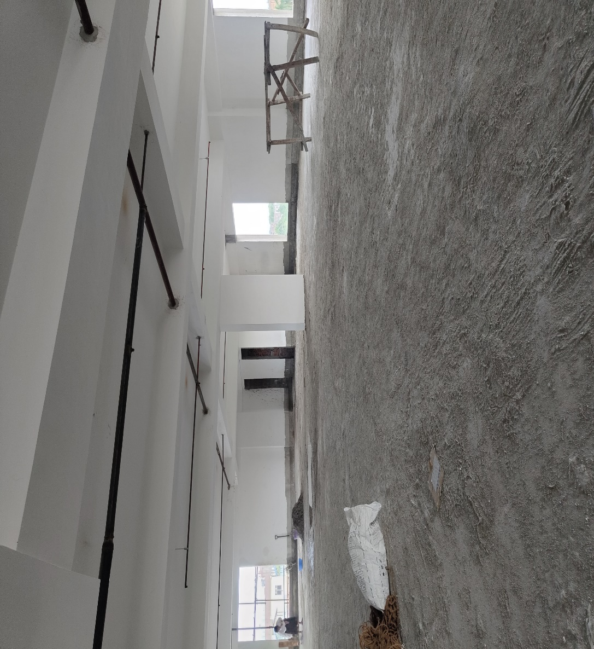
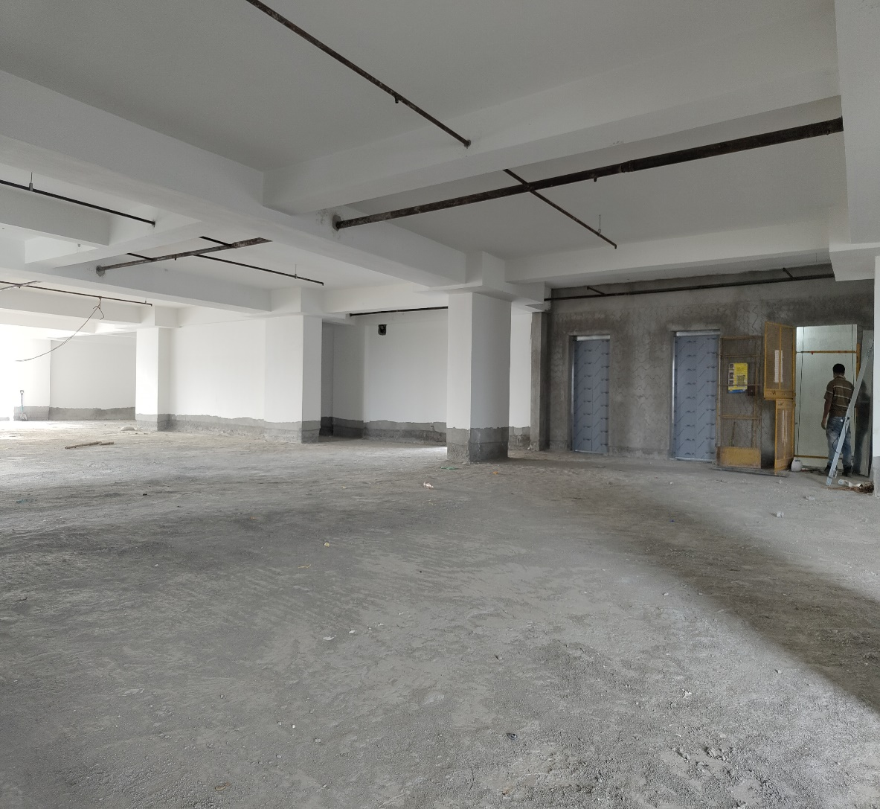
4th & 5th FLOOR PUTTY PRIMER COMPLETED

Slide 8
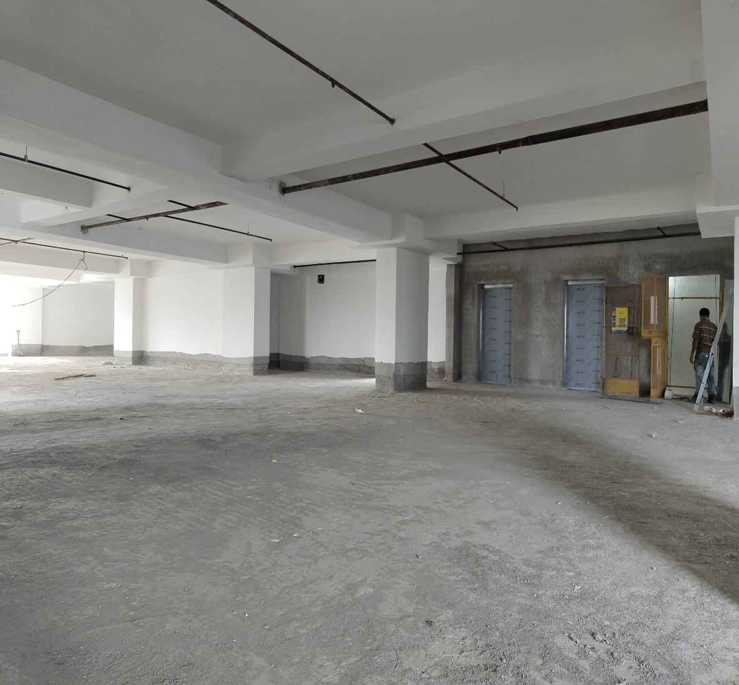
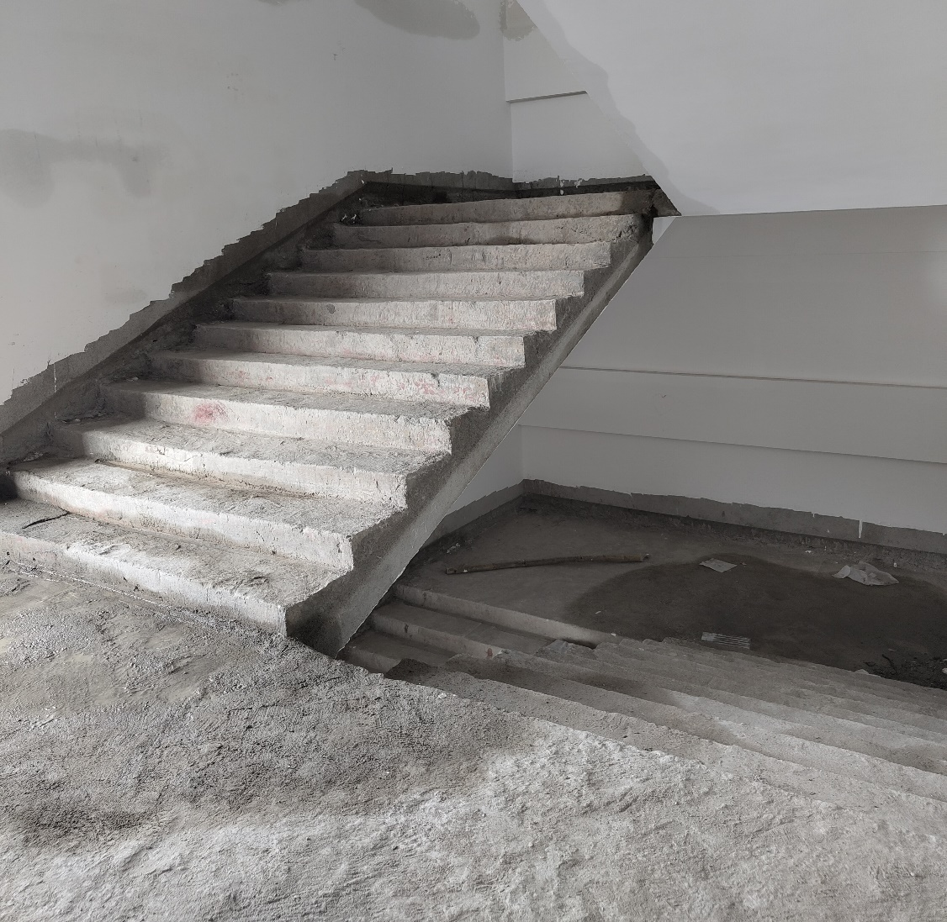
6th FLOOR / STAIRCASE PUTTY PRIMER COMPLETED

Slide 9
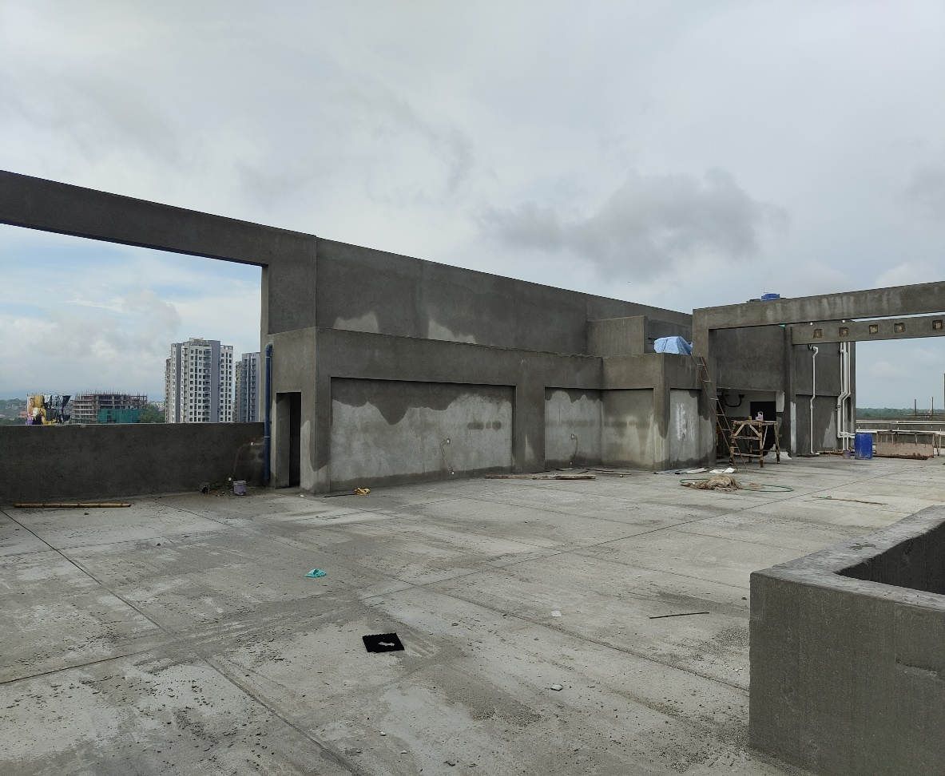
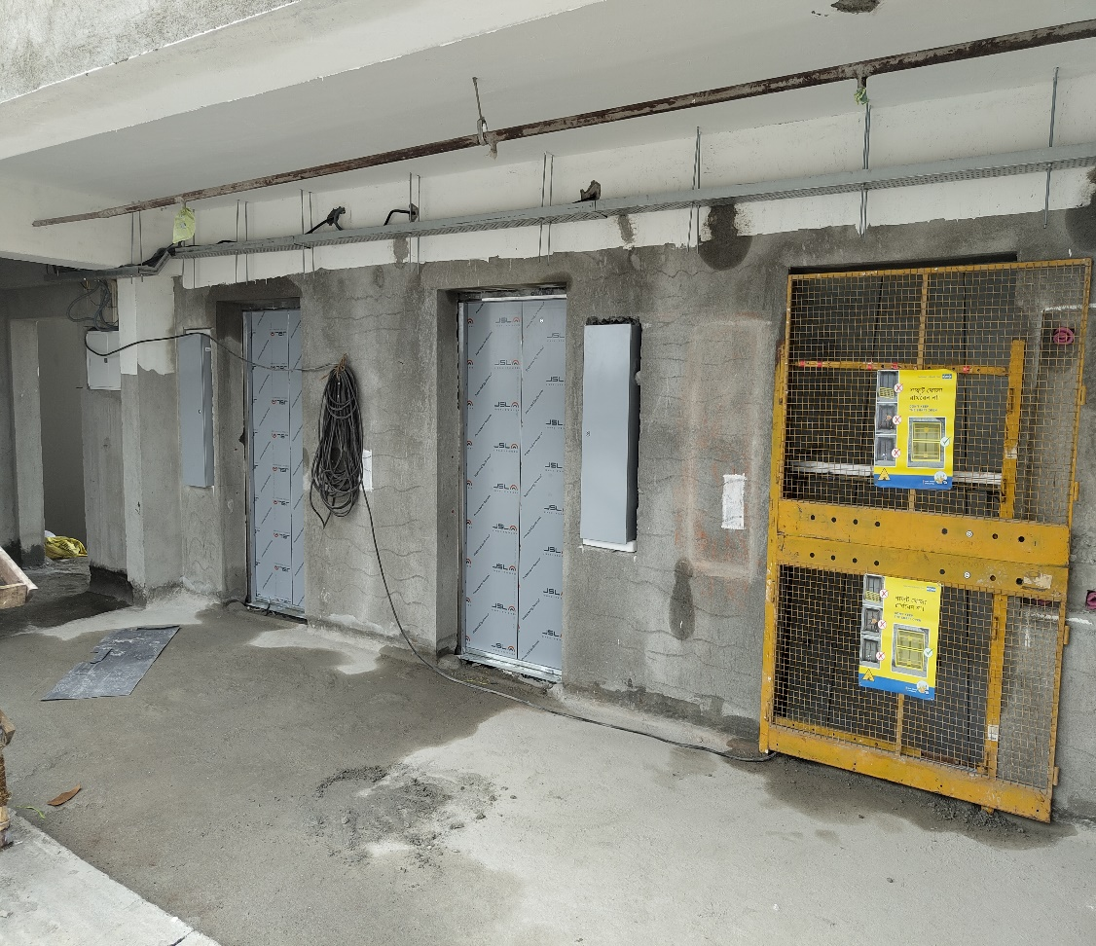
TERRACE / LIFT PLASTER & WATERPROOFING COMPLETED / LIFT WORK IN PROGRESS

Slide 10
Contact Us -
Address – 7th Avenue, Sevoke Road
Opp. Vega Circle Extension
Siliguri - 734008
Phone – 9051855355
Email – rpkrealty.slg@gmail.com

